Slide 1
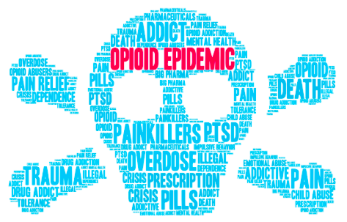
Why Do So Many People Use Drugs?
In Oregon*:
9.6% suffer from a Substance Use Disorder = 395,000 individuals
75% of Foster Care placements involve parental SUD
David Labby MD PhD
Health Share of Oregon –
October, 2019
*Governor’s Substance Use Policy Agenda 2018

Slide 2
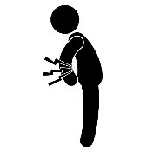
Oregon and prescription opioids
Prescription Opioids In Oregon: Who Is Using Them For What?
Medical Use -- Pain Treatment (>900,000)
In 2016, almost 1 in 4 Oregonians received a prescription for opioid medications
~20% of Oregonians have chronic pain (760,000)
Non-Medical Use: (212,000)
Tied for 2nd in the nation in 2012-2013; 1st in 2010-2011.¹
5% of population
3-5% transition to heroin… do the math: 3-5% x 212,000 = 6-10,000 transition to heroin
1 SAMHSA National Survey on Drug Use and Health, state level data
Notes:
How does this translate in to real numbers in Oregon?

Slide 3
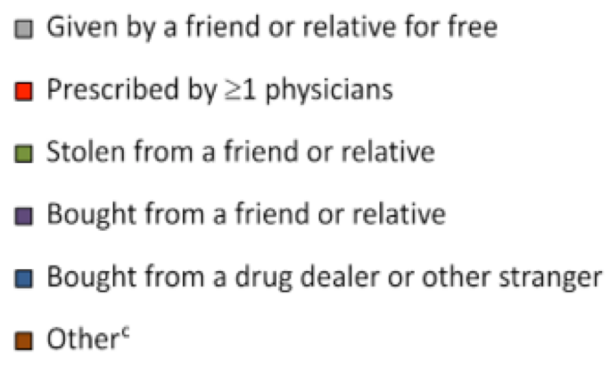
Where Do Non-Medical Users Get Rx Opioids?
Jones, Paulozzi, et al. JAMA Int Med 2014
Notes:
How does non medical use mostly happen? It is not our our patients…. It is their “friends...”

Slide 4
Why do so many people want / need drugs? What Is The Epidemic? The emerging bigger picture…
Notes:
So why are our “friends” so attracted opioids. Whats the bigger picture?

Slide 5
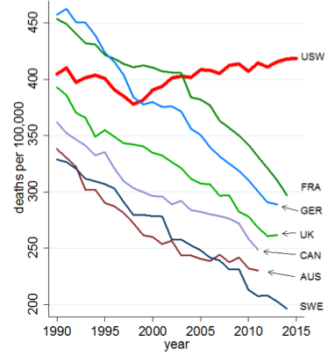
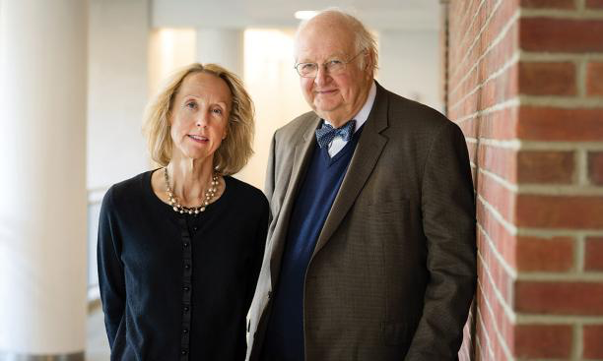
US all-cause mortality rates, ages 45-54
Professors Ann Case, Angus Deaton. Princeton University
Notes:
2015 Angus Deaton and Ann Case at Princeton First noted increased all cause mortality for 45-54 yos

Slide 6
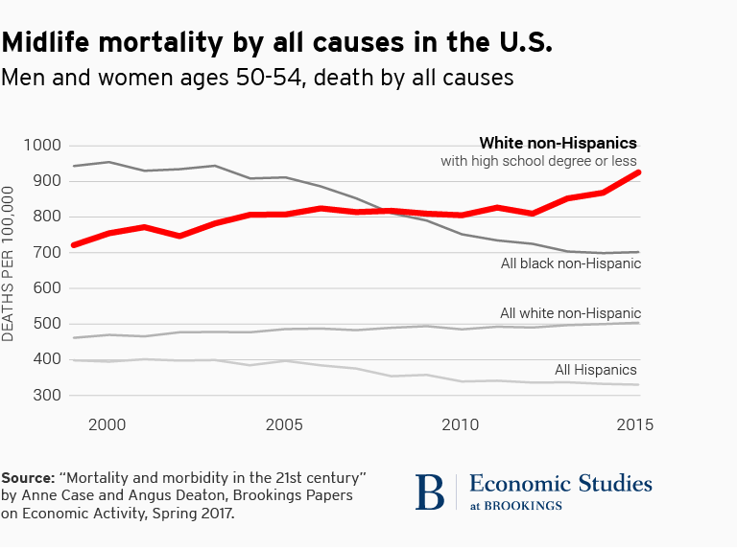
Notes:
Drill down: Mostly for those with HS or less education

Slide 7
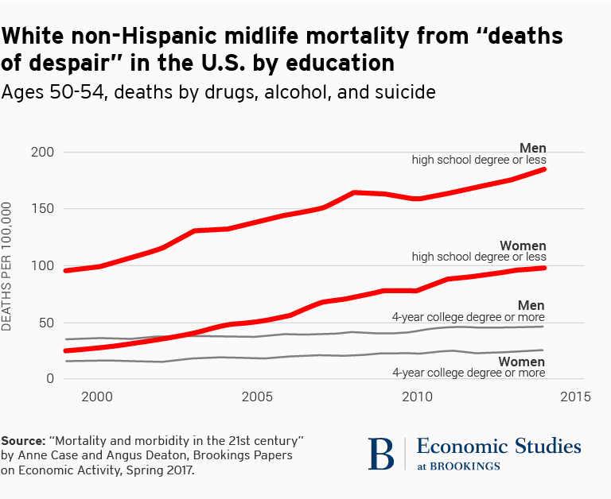
Notes:
Drill down: Mostly driven by deaths from drugs alcohol or suicide – “deaths of despair”

Slide 8
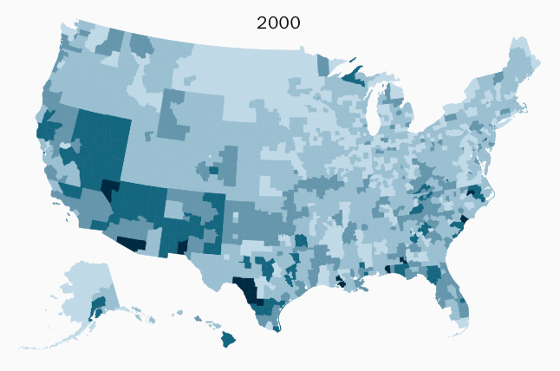
“Deaths of Despair” for white non-Hispanics, Ages 45-54
Notes:
Worse in certain part of the country vs others.

Slide 9
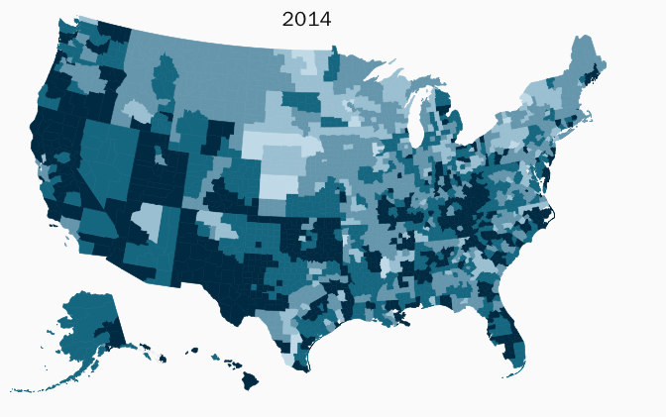
“Deaths of Despair” for white non-Hispanics, Ages 45-54
Notes:
Worse from 2000 to 2014

Slide 10
Why?
Angus / Deaton hypothesis:
Decline in blue collar jobs since 1970s, especially for those with less than a college degree
Major impact on white working class men
Fewer jobs, lower wages, lower returns on experience
Reduced marriage rates, higher divorce, worse family lives
Increases in reports of poor health
Increasing poor mental health
Increased incidence of chronic pain
Loss of economic supports
Loss of social supports
Increased suicide
Increasing substance use
Alcohol
Drugs
“This process was unfolding before heavy-duty prescription opioids flooded the market, but their presence has heightened its impact.”
Notes:
Their interpretation: blue collar economic dislocation.

Slide 11
What we found when we asked: “What happened to you?”
What are the life experiences that lead to bad health outcomes?
Formal qualitative study of “Adverse Life Events”
Building on the “Adverse Childhood Experiences Study” (1998 Felitti / Anda)
Notes:
How does this societal narrative fit with what we know about our patients?
We studied this in the early days of CCOs and the focus on High Utilizers – based on our understanding of ACEs

Slide 12
What We Found: Hard Lives
Overall Health Share Members
43% had 4+ Adverse Childhood Experiences (National Average: 14%)
Highest (40+%): Physical abuse / neglect, household substance abuse, parental divorce
Only 20% reported NO ACEs; national average = 41%
Over half reported they struggled with school; 27% did not graduate High School or get a GED
33% ran away from home
39% reported substance abuse; 28% in childhood
41% were homeless at sometime; 22% homeless in childhood
40% struggled to find work
56% reported verbal abuse by a loved one; 26%, physically abused
36% had been in jail

Slide 13
Higher Complexity = Higher Life Adversity
Medical Complexity
 | Low | High
 | % | %
ACE score
ACEs=0 | 27.26 | 16.69
ACEs>4 | 32.32 | 54.77
Struggle with schoolwork | 43.32 | 62.42
Did not graduate high school | 21.90 | 29.76
Substance abuse ever | 27.60 | 59.22
Homeless ever | 26.61 | 54.72
Ran away from home | 17.84 | 40.80
Physical abuse from a loved one | 21.93 | 37.22
Verbal abuse from a loved one | 46.68 | 70.46
Jail | 24.85 | 48.05
Notes:
Low complexity adversity rates are lower than the group average, though still high.

Slide 14
Highest Adversity Rates = 55% of Medically Complex With High ACEs
 | ACE>4 (42.59%)
 | Low | High
 | % | %
Struggle with schoolwork | 64.86 | 69.16
Did not graduate high school | 22.62 | 32.32
Substance abuse ever | 47.5 | 75.88
Homeless ever | 45.12 | 75.64
Ran away from home | 36.52 | 57.81
Physical abuse from a loved one | 46.67 | 52.19
Verbal abuse from a loved one | 66.17 | 86.57
Jail | 35.54 | 56.61
Notes:
High ACE Low group has higher than population average adversity

Slide 15
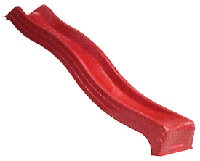
What We Are Most Trying to Prevent:
Cascading adverse life events that derail a healthy life
Development of chronic conditions
Multi-generational impacts
Unintended pregnancy
Chronic illness, Substance use, Mental illness, Criminality, Isolation,
Disability
21 yo +
12-21 yo
Job Insecurity
6-12 yo
Social Deprivation
5 yo
Risk Behaviors
Housing
Insecurity
3 yo
Kindergarten
School Failure
Substance Use Unhealthy Relationships
Birth
Poor Attachment
Behavioral Problems Skill Deficits
Pregnancy
Parents not able / ready to “parent”
Abuse Neglect
Adult violence, SUD
Notes:
In effect we end up with Cascading adverse life events…

Slide 16
What is happening … to US?
Not just: What is happening to them?
Nationally representative sample (1529):
24%: “I think society should be burned to the ground”
40%: “When it comes to our political and social institutions, I cannot help thinking ‘just let them all burn”
40%: “We cannot fix the problems in our social institutions, we need to tear them down and start over”
Petersen, Osmundsen, Arceneaux, “A ‘Need for Chaos” and the Sharing of Hostile Political Rumors in Advanced Democracies,” manuscript from American Political Science Association meeting 2019.
Notes:
Our Increasingly contentions soceity

Slide 17
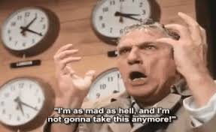
Notes:
From Network

Slide 18
Despair / Suicide in Oregon
Statewide suicide rate (2017): 17.8 / 100,000
Higher than national rate: 14 / 100,000
US Data: for every person who dies, 25 people attempt suicide and live
And 280 others think seriously about suicide
The math: 17.8 x 280 = 4,984 / 100,000 = (5%)
Is 1 person in 20 is thinking seriously about suicide? … What does this mean for our practices?
Suicide Survivors Share Stories: Oregonian Sept 16, 2019

Slide 19
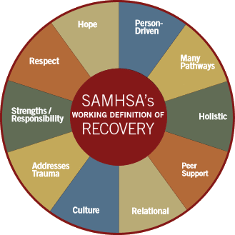
From Despair to Hope
If despair is defined as “the complete loss of hope” we need to be in the the hope business and not just the healing business
“Hope is the catalyst of the recovery process…”

Slide 20
The Hope Practice Model…
From Care Management to “Hope Management”…
Expects and prepares for complexity – welcomes those with complex issues as a priority to serve …
and not with barriers to access or stigma
Is Trauma Informed, fostering safety and trust; promoting choice, empowerment and collaboration
Is evidence based and longitudinally recovery oriented
Walks along side those in recovery, including during recurrence of use
Is holistic, creating partnerships with other service providers, peers and allies, and natural, culturally specific supports

Slide 21
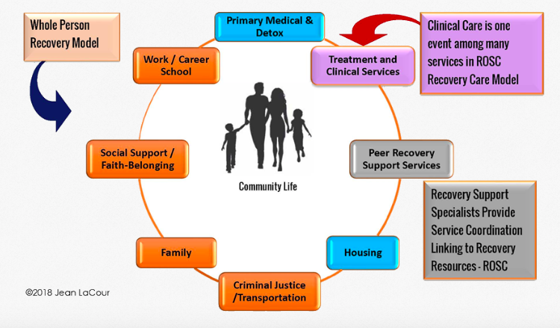
Recovery Oriented Systems of Care (ROSC): From: How do we get the client into treatment? To: How do we support the person’s overall process of recovery?
https://netinstitute.org

Slide 22
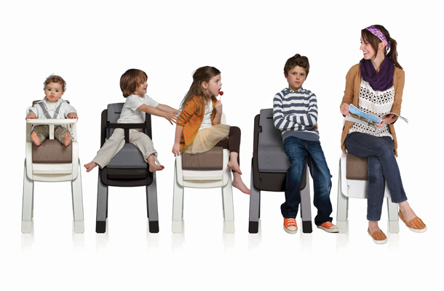
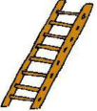
Our Goal:
A healthy, productive next generation
Healthy, productive adult
21 yo +
12-21 yo
Healthy Lifestyle
6-12 yo
Positive Relationships
5 yo
Academic Success
3 yo
Ready for kindergarten
Birth
Strong Attachments
Pregnancy
Healthy Mom / Child
Wanted Pregnancy
Notes:
Ultimately this is about making it possible for everyone to have a healthy productive fulfilling future.
Ultimately it is about promoting equity and social justice… and there is no better work.
Thank you for being here. Next year, bring your friends and lets double or triple the effort.

