Slide 1
Harm Reduction in Primary Care
PRESENTED BY: Jonathan Robbins, MD, MS
OHSU General Internal Medicine

Slide 2
Disclosures
I have nothing to disclose.

Slide 3
Learning Objectives
1. Define harm reduction and locate within the continuum of care for SUDs.
2. Mitigate overdose risk with patients.
3. Learn principles of safer injection.
4. Employ an evidenced-based approach to prevent communicable infections.

Slide 4
Harm Reduction
A set of practical strategies and ideas aimed at reducing negative consequences associated with drug use.
Harm reduction is also a movement for social justice built on a belief in, and respect for, the rights of people who use drugs.
https://harmreduction.org/about-us/principles-of-harm-reduction/

Slide 5
Harm reduction is also
Part of the continuum of care
Relationship building
Treatment

Slide 6
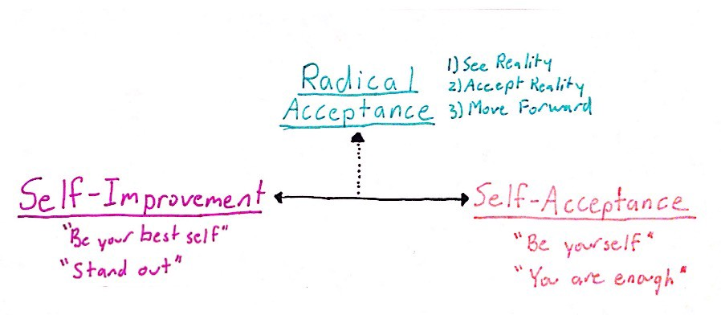
Harm reduction is not
What we do when nothing else works
Encouraging people to use drugs

Slide 7
How to Discuss
What harms most concern you?
I know you aren’t planning on using again, but can we discuss what would happen if you did?

Slide 8
Naloxone Eligibility
h/o OUD, h/o overdose
MEDD > 50, opioids + benzos
Concern for friends, family
Community safety
https://www.cdc.gov/vitalsigns/naloxone/index.html

Slide 10
Overdose Prevention
Don’t use alone
Changes in tolerance
“Tester shot”
Watch for fentanyl
8% of methamphetamine samples contained fentanyl (2013-2018)
LaRue in JAMA Network Open 2019
Binswanger in NEJM 2019
Binswanger in Ann Internal Med 2013
Stein in J Subst Abuse Treat 2019
Notes:
“The risk of overdose death after release from correctional facilities has been shown to be more than 10 times the risk in the general population.” – Binswanger NEJM

Slide 11
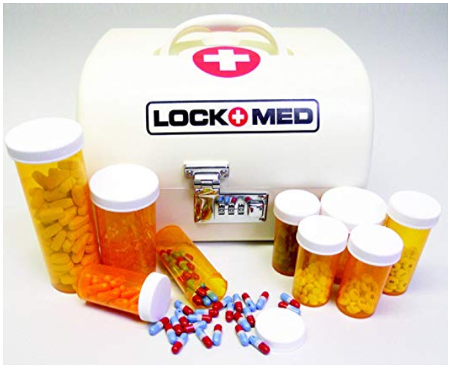
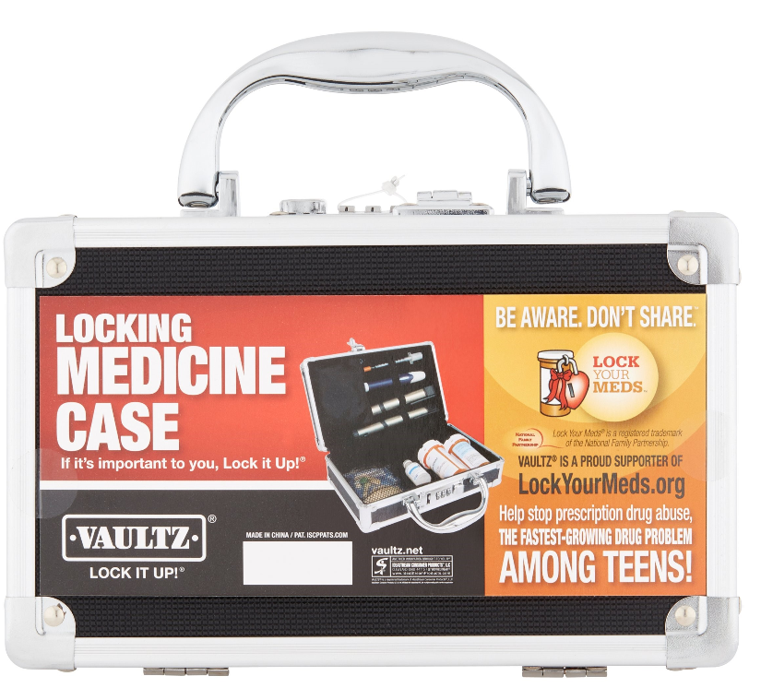
Safe Storage
Gaither in JAMA Pediatr 2016
Bartels in PLoS One 2016
Notes:
Gaither: “During the course of 16 years, hospitalizations attributed to opioid poisonings rose nearly 2-fold in the pediatric population. Hospitalizations increased across all age groups, yet young children and older adolescents were most vulnerable to the risks of opioid exposure. Mitigating these risks will require comprehensive strategies that target opioid storage, packaging, and misuse.”

Slide 12
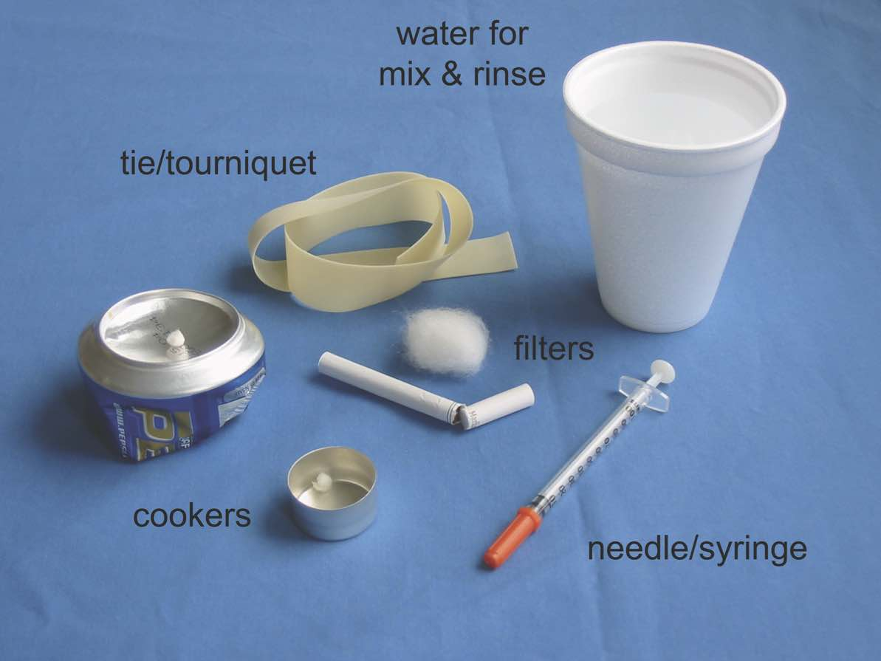
https://www.healio.com/infectious-disease/hepatitis-c/news/

Slide 13
Injection Technique
Clean the hands
Clean the skin
Clean needles/rigs (don’t share filters, cookers)
Don’t use alone
Use needles bevel up
Use a filter whenever possible
Test for fentanyl
Clean water
Thakarar K in Postgrad Med J. 2016

Slide 14
Syringe Exchange
Astoria: Pier 32, at the end of 32nd Street behind Safeway, every Thursday from 2:30 – 3:30 p.m.
Seaside: Providence Seaside Hospital, 725 S. Wahanna Road, in the parking lot. The first event on their campus will take place on Thursday, February 1st from 11:30 – 12:30 p.m.
Warrenton: Off Neptune Dr. between Joanne Fabric Store and grocery side of Fred Meyers Parking lot from 1 – 2 p.m.
https://www.oregonpainguidance.org/regions/north-coast/syringe-exchange-information/

Slide 15
No shows
1st no-show
Behavioral health reaches out
Shorten prescription to 7 days
2nd no-show
Shorten to 3-4 days
3rd no-show
Reduce bup/nlx by 2-4 mg per fill
Notes:
Clinic policy, Audience approach

Slide 16
Active use, polysubstance use
Remember what treats what
Any engagement with care is better than no engagement
Active use, return to use is not treatment failure

Slide 17
http://ultimategerardm.blogspot.com/2016/01/wikimedia-perfection-is-enemy-of-good.html

Slide 18
Infections in SUD
Prevention
vaccination
condoms, PrEP
decreased injection; safer injection
Screening
Baseline
Periodic
Treatment
HCV, HIV, other STIs, abscesses
Slides courtesy Jorge Mera MD

Slide 19
1st Visit Labs
Hepatitis B:
Hepatitis B surface antigen (HBsAg)
Hepatitis B surface antibody (HBsAb)
Hepatitis B total core antibody (HBcAb)
Hepatitis A total antibody
Hepatitis C antibody or RNA
HIV 4th generation test
RPR/Treponemal test
GC/Chlamydia
in urine, pharyngeal and rectal PRN
Physical Exam:
Soft tissue exam
Cardiac murmurs

Slide 20
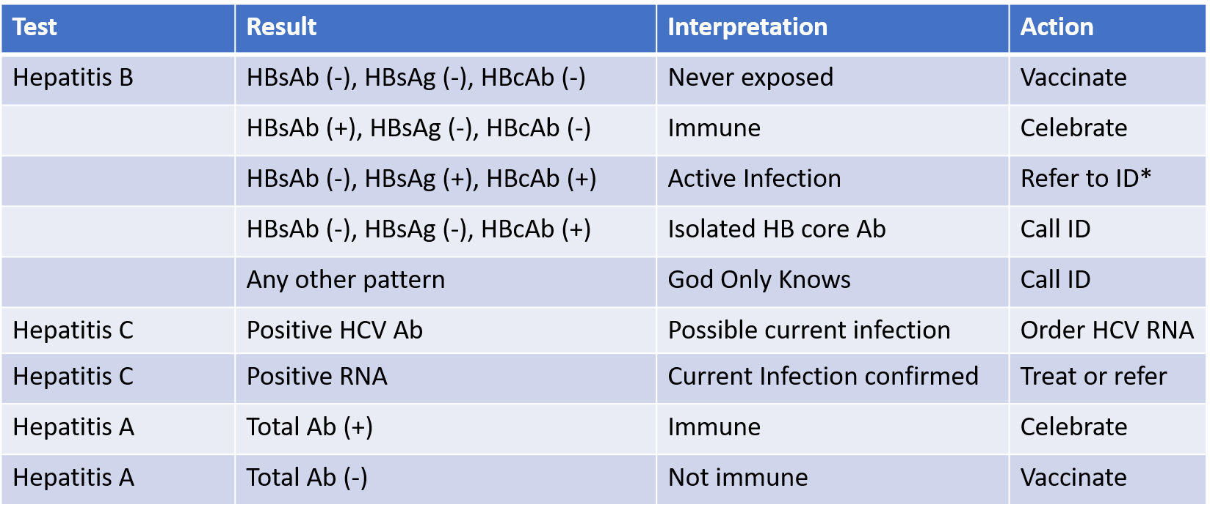
2nd Visit: Review and Take Action
* Evaluate for PrEP

Slide 21
* Evaluate for PrEP

Slide 22
Lab Frequency
Test | Result
Hepatitis C | Most guidelines recommend once a year but may be more frequent
Hepatitis A | Once since if negative vaccination should be offered
Hepatitis B | Once since if negative vaccination should be offered
GC/Chlamydia Syphilis/HIV | Every 6 months if they are on PrEP and anytime they report an unprotected exposure

Slide 23
3rd Visit: Vaccines, sexual hx
Review vaccines
Hepatitis A and B
Pneumococcal 23 (and PCV13)
TdAP
HPV (< age 26; discuss ages 27-45)
Seasonal flu
https://www.cdc.gov/vaccines/schedules/hcp/imz/adult.html

Slide 25
PrEP: Indications
Men Who Have Sex With Men (MSM) | HIV positive partner Recent STI (particularly syphilis) High number of sex partners Inconsistent/no condom use Commercial Sex Work
Heterosexual Men & Women | 1-5. Same as above 6. High prevalence area
People Who Inject Drugs (PWID) | HIV positive injection partner Shares injection equipment Recent drug treatment + still injecting
https://www.cdc.gov/hiv/pdf/risk/prep/cdc-hiv-prep-guidelines-2017.pdf

Slide 26
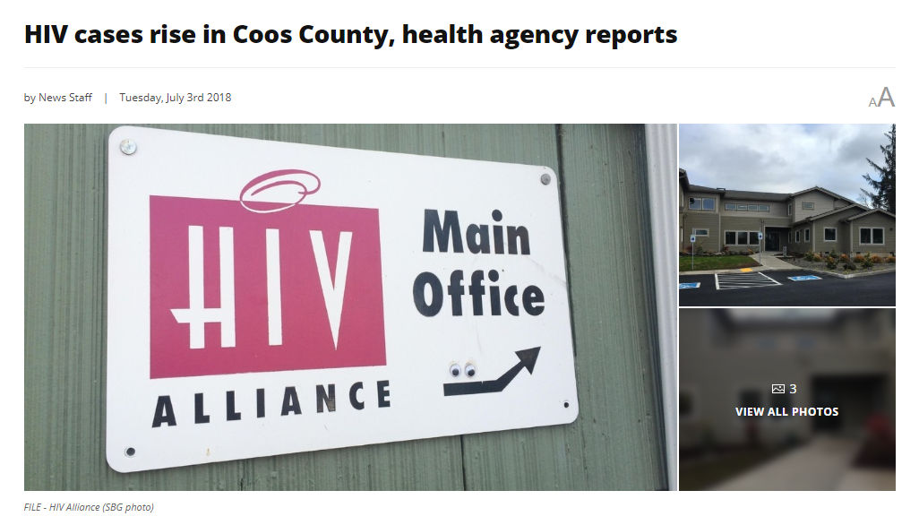

Slide 27
Contraception
Barrier (male and female condoms)
LARC (IUD, implantable)
Irreversible contraception ?
Uuskula in Harm Reduction, 2018
https://nhchc.org/wp-content/uploads/2019/08/Reproductive-Health-Care.pdf

Slide 28
Dental Health
Encourage hydration
Dental referrals
Toothbrushes, toothpaste
Laslett in Addiction, 2008

Slide 29
What questions do you have?

Slide 30
Conclusions
1. Harm reduction is integral to the care of patients with substance use disorders.
2. Counseling patients on overdose risk and injection safety will reduce SUD-associated comorbidity.
3. Patients with active use are eligible for a battery of screening tests, vaccinations, and prevention efforts.

Slide 31
Thank You !
robbijon@ohsu.edu

